Slide 1
SUBSPACES
MATH 15 - Linear Algebra
Engr. Dan Andrew Magcuyao
Department of Mathematics

Slide 2
OBJECTIVES
At the end of this lesson, the students are expected to:
Define a subspace
Identify the properties subspaces.
Express a given vector as linear combination of vectors.
Determine Linear Spans
Identify Linear Independence of vectors.

Slide 3
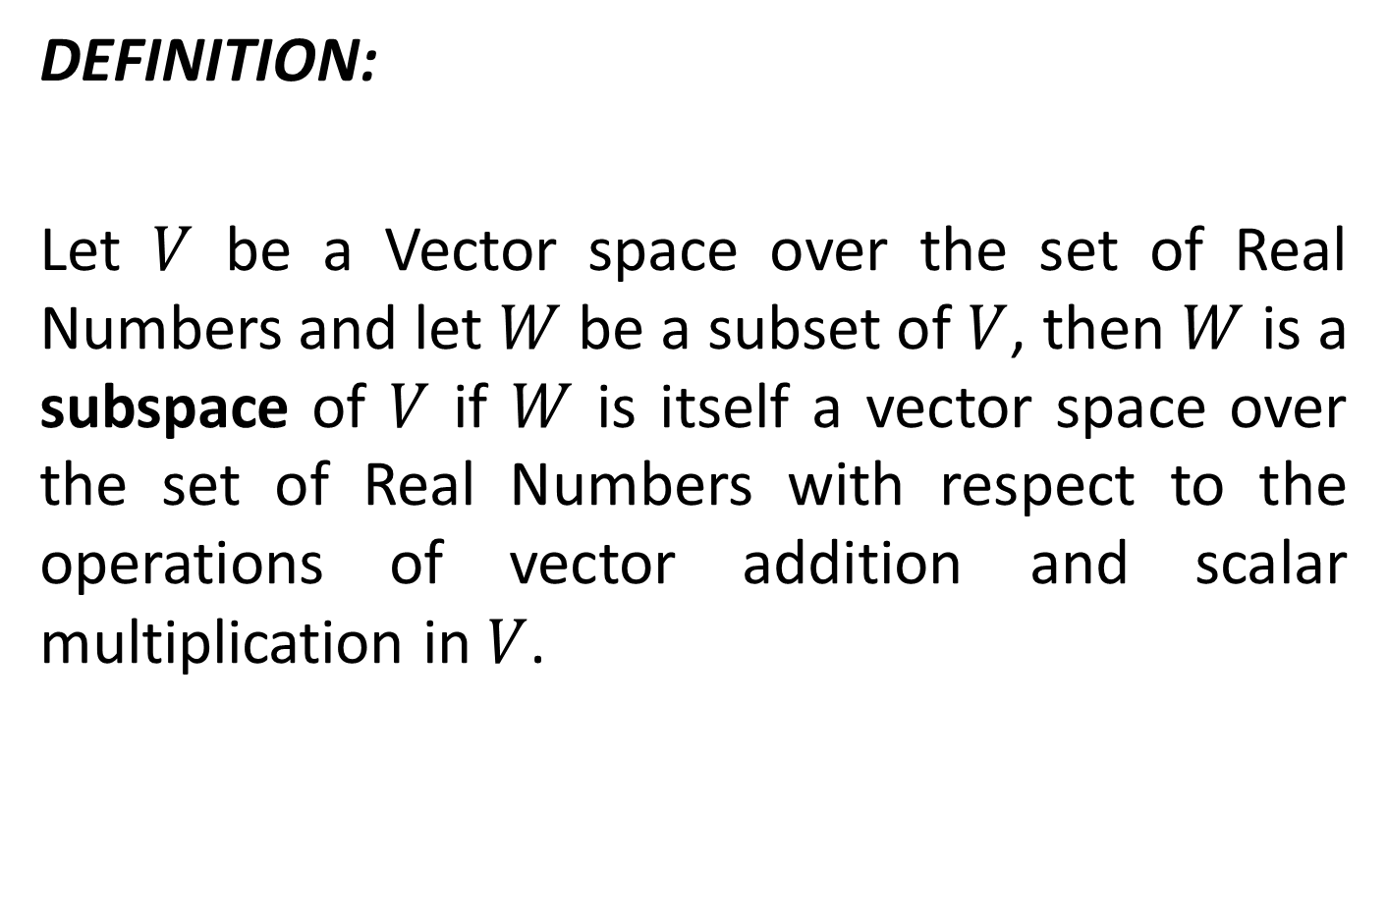
SUBSPACE
DEFINITION:
Let $V$ be a Vector space over the set of Real Numbers and let $W$ be a subset of $V$, then $W$ is a subspace of $V$ if $W$ is itself a vector space over the set of Real Numbers with respect to the operations of vector addition and scalar multiplication in $V$.

Slide 4
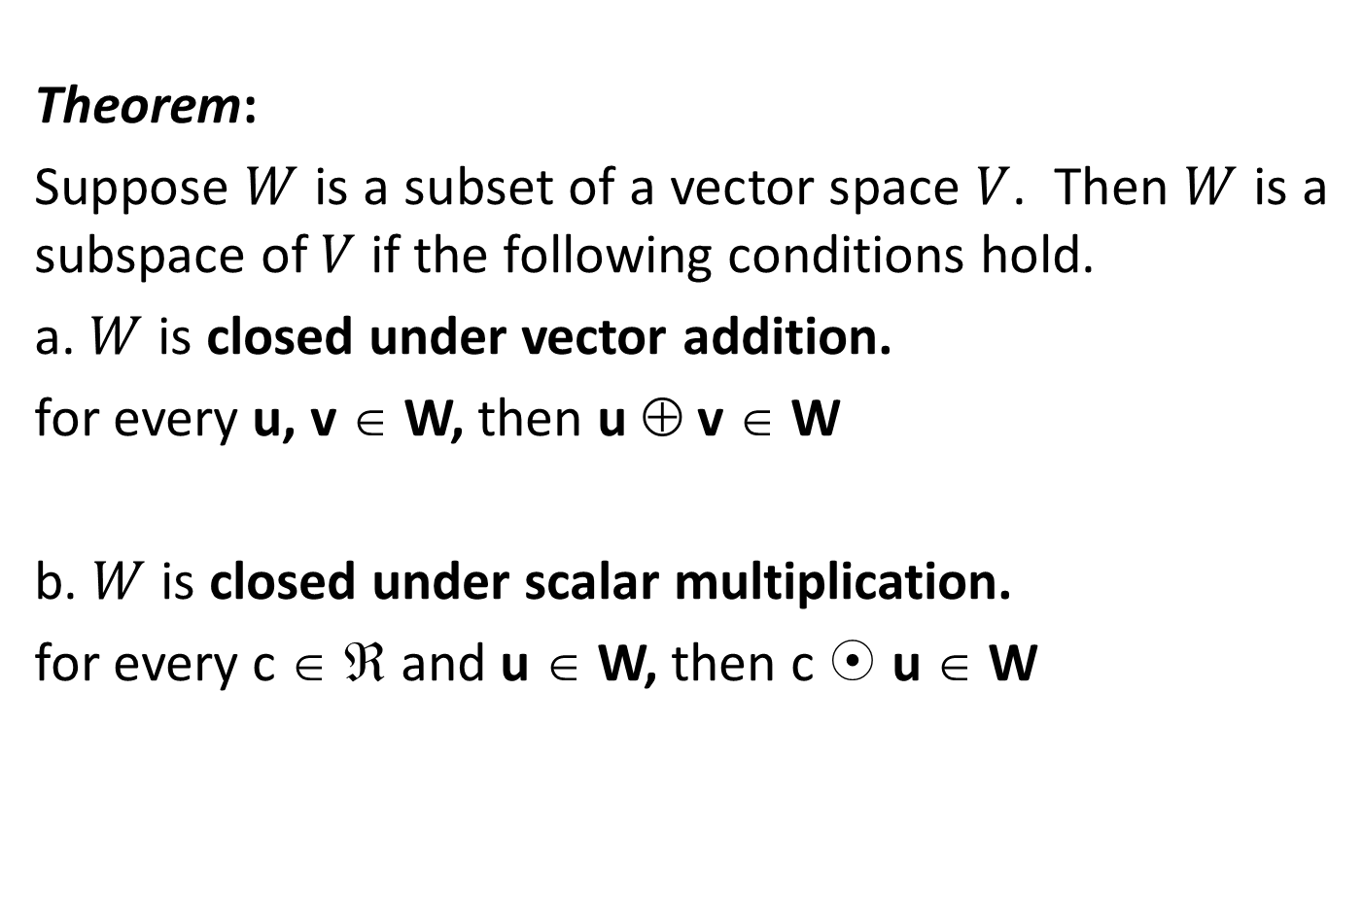
SUBSPACE
Theorem:
Suppose $W$ is a subset of a vector space $V$. Then $W$ is a subspace of $V$ if the following conditions hold.
a. $W$ is closed under vector addition.
for every u, v ∈ W, then u ⊕ v ∈ W
b. $W$ is closed under scalar multiplication.
for every c ∈ ℜ and u ∈ W, then c  u ∈ W

Slide 5
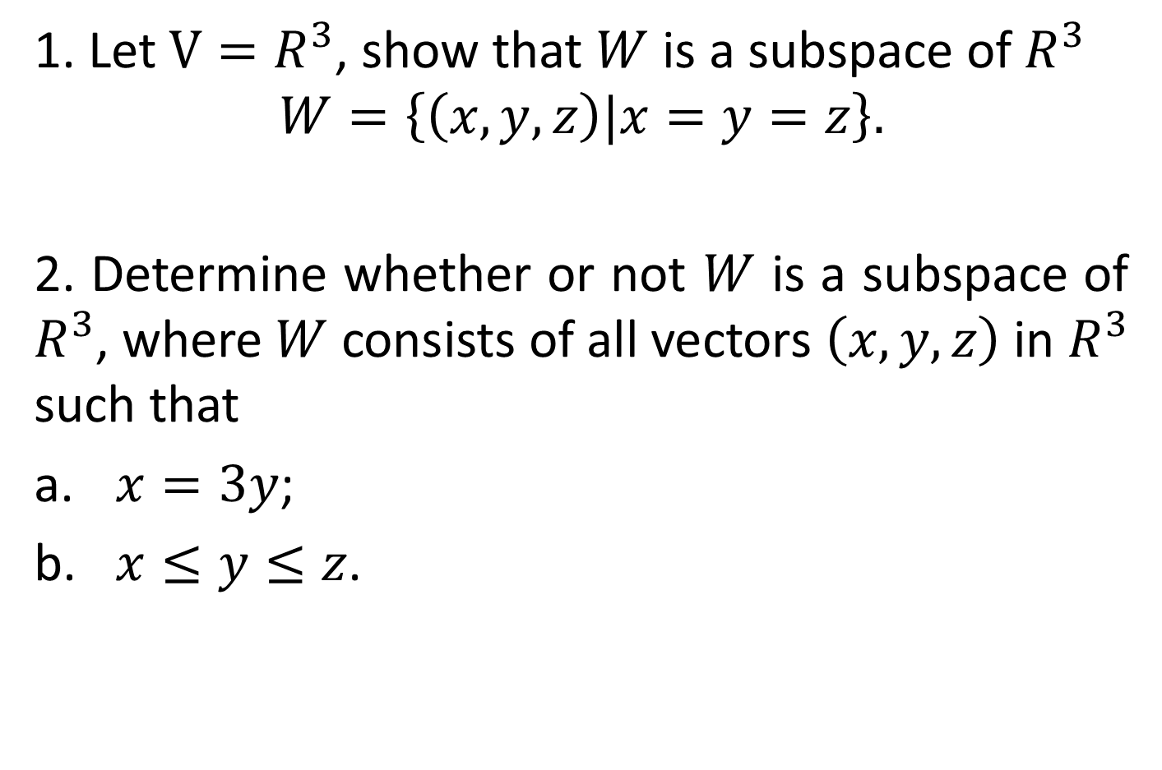
EXAMPLES
1. Let $V=R^{3}$, show that $W$ is a subspace of $R^{3}$
$$W=\left\{\left(x, y, z\right)|x=y=z\right\}.$$
2. Determine whether or not $W$ is a subspace of $R^{3}$, where $W$ consists of all vectors $\left(x, y, z\right)$ in $R^{3}$ such that
$x=3y$;
$x≤y≤z$.

Slide 6
SUBSPACE
Theorem:
There are at least two vectors in the subspace W of V, the zero vector and itself.
Examples:
Let V = R³, show that W is a subspace of R³
W = {(x,y,z)| (x=y=z)}
2. Determine whether or not W is a subspace of R³, where W consists of all vectors (x,y,z) in R³ such that a. x=3y
b. x < y < z

Slide 7
EXAMPLES
Examples:
Let V = R³, show that W is a subspace of R³
W = {(x,y,z)| (x=y=z)}
2. Determine whether or not W is a subspace of R³, where W consists of all vectors (x,y,z) in R³ such that a. x=3y
b. x < y < z

Slide 8
SUBSPACE
Theorem:
For every vector u,v ∈W, and a,b∈ ℜ, the linear combination au + bv ∈ W
Examples:
Let V = R³, show that W is a subspace of R³
W = {(x,y,z)| (x=y=z)}
2. Determine whether or not W is a subspace of R³, where W consists of all vectors (x,y,z) in R³ such that a. x=3y
b. x < y < z

Slide 9
LINEAR COMBINATION
Let V be a vector space over ℜ. A vector v in V is a linear combination of the vectors v₁, v_{2,} v_{3 …} v_{n} if there exist scalars c_{1,} c_{2,} c_{3,…} c_{n} ∈ ℜ , such that
v = c₁ v₁ + c₂ v₂+ c₃ v₃ +…+ c_{n} v_{n}
Alternately, v is a linear combination of vectors v₁, v_{2,} v_{3 …} v_{n} if there is a solution to the vector equation
v = x₁ v₁ + x₂ v₂+ x₃ v₃ +…+ x_{n} v_{n}
where x_{1,} x_{2,} x_{3,…} x_{n}

Slide 10
EXAMPLES
1. Express v = (1, -2, 5) in R³ as a linear combination of the vectors
v₁ = (1,1,1) v₂ = (1,2,3) v₃ ₌ (2, -1, 1)
2. Express the polynomials v = P(t) = t² +4t -3 as a linear combination of the polynomials
p₁(t) = t²-2t+5 p₂(t) = 2t² – 3t p₃(t) = t+1
3. Express M = as a linear combination of the matrices
A = , B = , C=

Slide 11
VECTORS BELONGING TO SPANNING SET
A vector v belongs to the spanning set
S = { v₁, v_{2,} v_{3 …} v_{n} } if there exist the constants c_{1,} ,c_{2,} c_{3,…} c_{n} in the linear combination of the vectors v₁, v_{2,} v_{3 …} v_{n}
That is v belongs to the spanning set if in the relations
v = c₁ v₁ + c₂ v₂+ c₃ v₃ +…+ c_{n} v_{n}
c_{1,} ,c_{2,,} c_{3,} exists

Slide 12
EXAMPLES
Determine if v = (1, -2, 5) in R³ belongs to
the span S = {v₁ ,v₂ ,v₃ }
v₁ = (1,1,1) v₂ = (1,2,3) v₃ ₌ (2, -1, 1)
2. Determine if the polynomial v = P(t) = t² +4t -3 belongs to the span S = {p₁ ,p₂ ,p₃ }
p₁(t) = t²-2t+5 p₂(t) = 2t² – 3t p₃(t) = t+1
3. Determine if M = belongs to the span S = {A,B,C}
A = , B = , C=

Slide 13
EXAMPLES
4. Determine if v = (1, -2, 5) in R³ belongs to
the span S = {v₁ ,v₂ ,v₃ }
v₁ = (1,1,1) v₂ = (1,2,3) v₃ ₌ (2, 3, 4)
5. Determine if the polynomial v = P(t) = t² +4t -3 belongs to the span S = {p₁ ,p₂ ,p₃ }
p₁(t) = t²-2t+5 p₂(t) = 2t² – 3t p₃(t) = t-10

Slide 14
SPANNING SET
Let V be a vector space over ℜ. Vectors v₁, v_{2,} v_{3 …} v_{n} in V is said to span V or to form the spanning set of V if every v in V is a linear combination of the vectors v₁, v_{2,} v_{3 …} v_{n}
That is v is a spanning set if in the relations
v = c₁ v₁ + c₂ v₂+ c₃ v₃ +…+ c_{n} v_{n}
c_{1,} ,c_{2,,} c_{3,} exists

Slide 15
EXAMPLE
Consider the vector space V=R³. Determine whether the following vectors form a spanning set for R³
1. Spanning Set = { e_{1,} e_{2,} e₃)
where e_{1,} = (1, 0, 0) e₂ = (0,1,0), e₃ = (0,0,1)
2. Spanning Set = { w_{1,} w_{2,} w₃)
where w_{1,} = (1, 0, 0) w₂ = (1,1,0), w₃ = (1,1,1)
3. The set { u₁, u₂ ,u₃}
where u₁ = (1,2,3), u₂ = (2,5,8), u₃ = (1,3,5)

Slide 16
LINEAR SPANS
THEOREM
If in solving for the solution A x = b using Gauss Jordan Elimination where A is the augmented form of the vectors in the set S = { v₁, v₂, v₃,…,v_{n}}, and zero row would exist for the Reduced Row Echelon Form of A, then the system is
Inconsistent
No solution, no values for c₁, c₂,…, c_{n}
S is not a spanning Set

Slide 17
LINEAR SPANS
THEOREM
If S = { v₁, v₂, v₃,…,v_{n}} is a set of vectors in the space V, then the set of all vectors in V that are linear combination of the vectors in S is denoted by the span S or span{ v₁, v₂, v₃,…,v_{n}} . If there is no value of the constants c₁, c₂ , c_{n} , then the following are equivalent:
Inconsistent system
No solution, no values for c₁, c₂,…, c_{n}
V does not belong to the span S

Slide 18
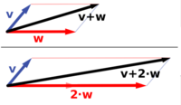
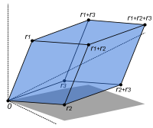
LINEAR SPANS

Slide 19
NON - LINEAR SPANS

Slide 20
LINEAR INDEPENDENCE
The vectors v₁, v₂, v₃,…,v_{n} in a vector space V as said to be linearly dependent if there exist constants c₁, c₂,…, c_{n} not all equal to zero (non trivial solution) such that
c₁ v₁+ c₂ v₂ + c₃v₃ + c_{n}v_{n} = 0
Otherwise v₁, v₂, v₃,…,v_{n} are called linearly independent if the constants c₁ = c₂=… c_{n}= 0 (trivial solution)

Slide 21
LINEAR INDEPENDENCE
Test for Linear Independence or Linear Dependence
1. Form the equation that leads to a homogeneous Linear System
c₁v₁ +c₂v₂ +c₃v₃= 0
2. Solve for c₁, c₂,…, c_{n} using Gaussian Elimination or Gauss Jordan Elimination
3. If the number of leading ones is
A: less than the number of unknowns, then the system is dependent, has infinite solution, and the homogeneous system has non trivial- solution and therefore conclude that the system is LINEARLY DEPENDENT.
B. Equal to the number of unknowns, then the system is
consistent, has unique solution, and the homogeneous system
has only trivial- solution and therefore the system is
LINEARLY INDEPENDENT.

Slide 22
EXAMPLE
1. Determine whether the given vectors are linearly dependent or linearly independent.
A. Given the vectors v₁ = and v₂ = .
B. Given the vectors v₁ = (1, 0,1,2) , v₂ = (0,1,1,2), v₃ = (1,1,1,3) .
C. Given the vectors P₁(t) = t²+t+2, P₂(t) = 2t²+t, P₃(t)= 3t²+2t+2.
D. Given the vectors v₁ = (1,1,2), v₂ = (2,3,1), v₃ ₌ (4, 5, 5).
E. Given the vectors u = t³ +4t²-2t+3 , v = t³+6t²-t+4,
w=3t³+8t²-8t+7

Slide 23
SUGGESTED READINGS
TEXTBOOKS
Elementary Linear Algebra, Bernard Kolman and David R. Hill, 7th ed., 2003
WEBSITES:
http://en.wikipedia.org/wiki/Vector_space

